Slide 1

WELCOME
history
Ecommerce Sales Dashboard Analysis
Profitability
Insights
Insights
Conclusions
Summary
Overview
Power BI Project

Slide 2
Objective:
To analyze and visualize eCommerce sales data for business decision-making
To identify top-performing states, products, and customers
To evaluate sales, profit, and customer trends over time
Dashboard Overview
Overview
Insights
Insights
Summary
Profitability
Conclusions
About the Dataset:
Data includes order amounts, quantities sold, profit, product categories, payment modes, states, and more
Sourced from eCommerce transaction records over a one-year period

Slide 3
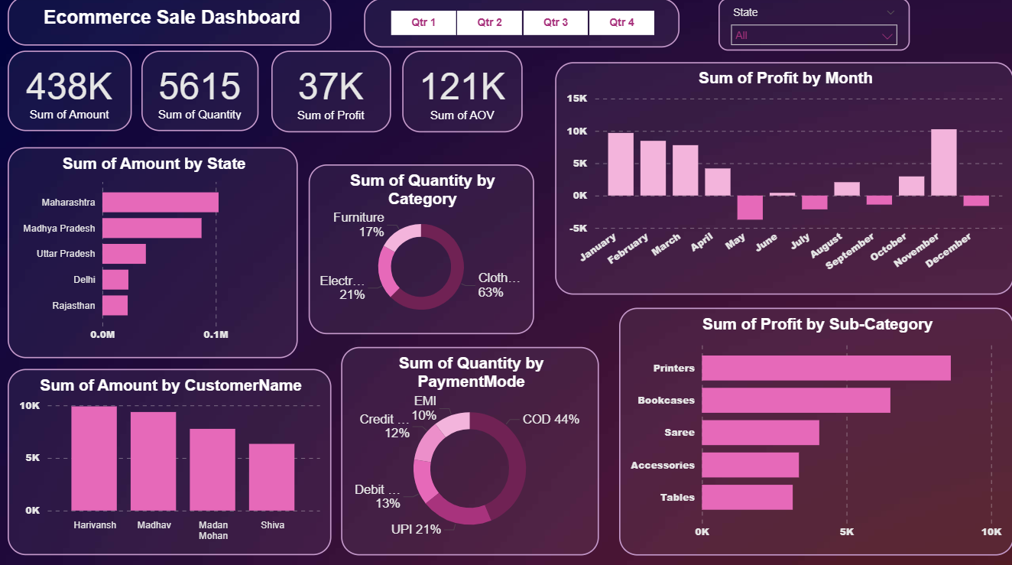
Dashboard Overview:
Profitability
Dashboard Overview
Conclusion
Insights
Insights
Summary
Overview
This Power BI dashboard provides a comprehensive and interactive visualization of sales, profit, and quantity metrics across different dimensions such as state, month, customer, product category, and payment method.

Slide 4



Key Metrics:
Dashboard Overview
Profitability
Insights
Conclusions
Insights
Summary
overview
438K
5615
37K
121K
Total Sales Amount
Total Quantity Sold
Total Profit
Average Order Value (AOV)
These metrics show overall business performance and transaction averages.

Slide 5
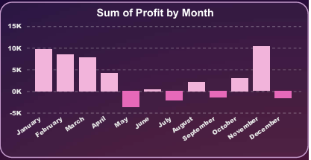
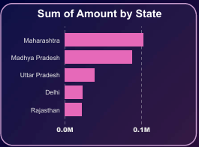
Regional & Monthly Insights:
Dashboard Overview
Profitability
Summary
Insights
Insights
Overview
Conclusions
Monthly Profit Analysis:
Regional Sales Insight:
Profits show peaks in January and December, with noticeable dips in some mid-year months.
Maharashtra and Madhya Pradesh are the top states for sales by amount.

Slide 6
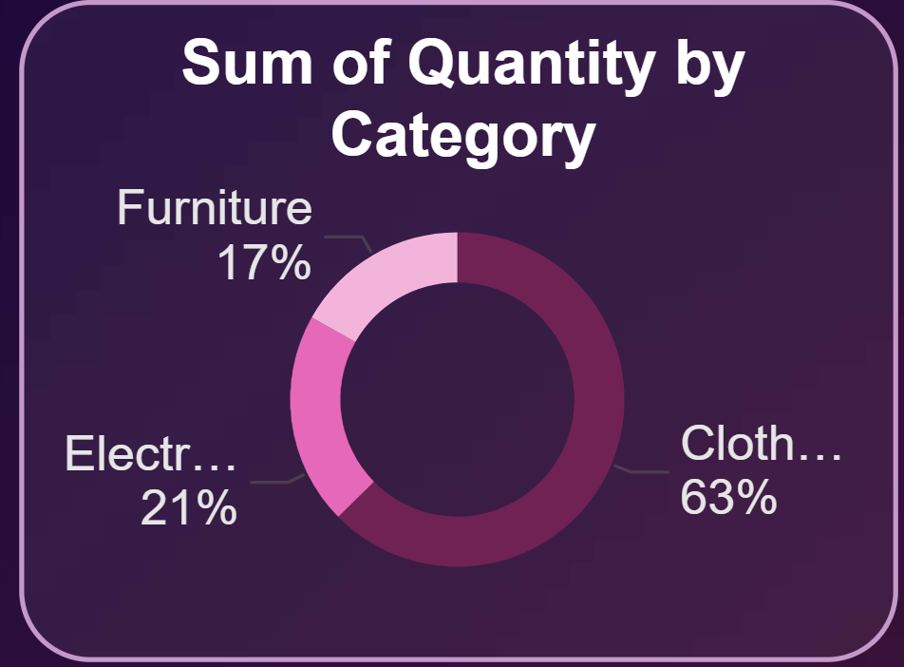
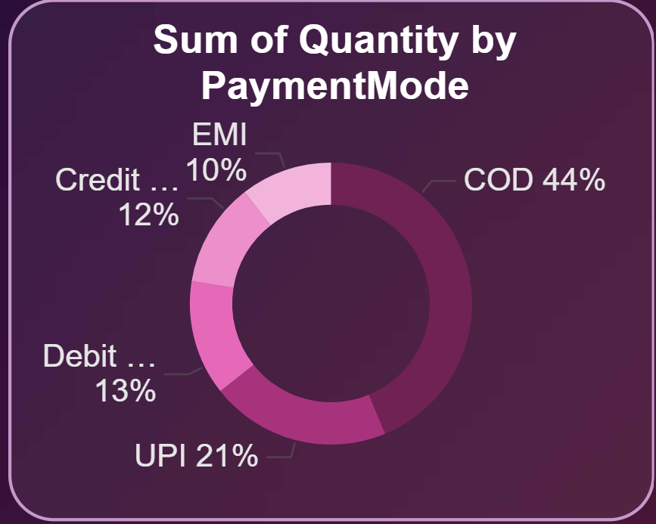
Category & Payment Insights:
Dashboard Overview
Profitability
Insights
Insights
Conclusions
Summary
Overview
Product Category Insights:
Payment Method Trends:
Clothing leads with 63% of quantities sold, followed by Electronics at 21%.
Cash on Delivery (COD) is the most preferred payment mode at 44%, followed by UPI (21%).

Slide 7
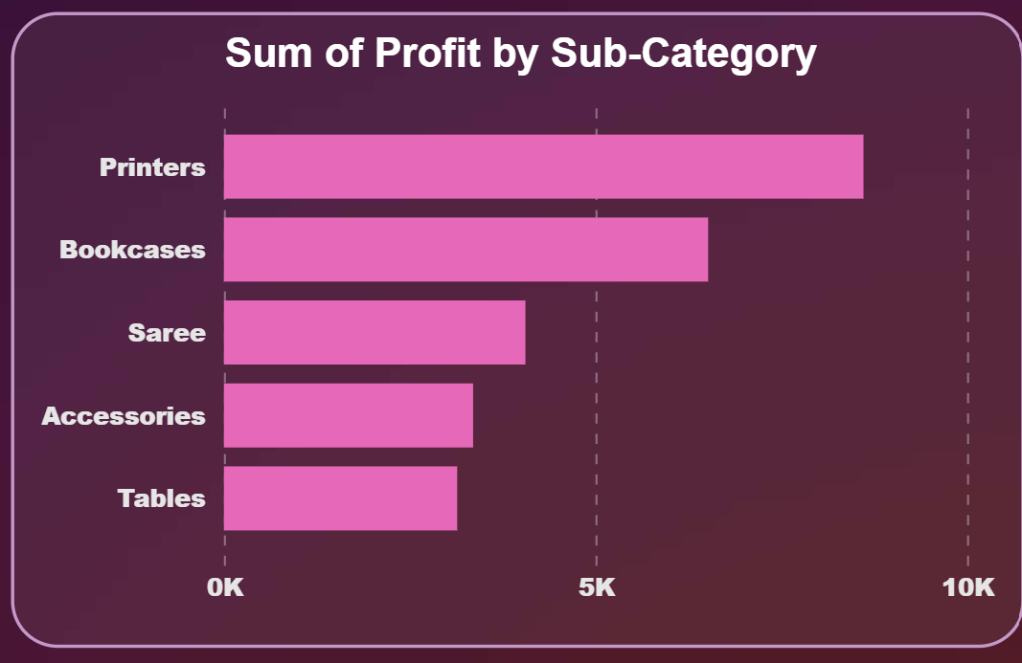
Conclusions & Recommendations:
Conclusions:
Sales and profits are concentrated in a few key states and sub-categories.
Seasonal peaks observed in January and December.
COD remains the preferred mode of payment.
Dashboard Overview
Conclusions
Insights
Insights
Recommendations:
Focus marketing efforts on top-performing states and sub-categories.
Prepare inventory for year-end sales boosts.
Encourage digital payment adoption to streamline transactions.
Profitability
Summary
Overview
Profitability by Sub-Category:
Printers and Bookcases generate the highest profit among sub-categories.
Saree, Accessories, and Tables etc. follow as other significant contributors.

Slide 8
Conclusions & Recommendations:
Conclusions:
Sales and profits are concentrated in a few key states and sub-categories.
Seasonal peaks observed in January and December.
COD remains the preferred mode of payment.
Dashboard Overview
Conclusions
Insights
Insights
Recommendations:
Focus marketing efforts on top-performing states and sub-categories.
Prepare inventory for year-end sales boosts.
Encourage digital payment adoption to streamline transactions.
Profitability
Summary
Overview
Profitability by Sub-Category:
Printers and Bookcases generate the highest profit among sub-categories.
Saree, Accessories, and Tables etc. follow as other significant contributors.

